Slide 1
Movie Recommender System
Movie Suggestions for old and new users

Slide 2
Problem Statement
OTT platforms like Netflix, amazon began by hosting some of the more popular tv shows and movies.
The sheer quantity of shows and movies would have become overwhelming if not for the recommendation systems implemented by these streaming platforms.
I personally have spent a long time simply browsing the shows and checking their ratings online before I start watching any show or movie on Netflix which led me to creating a movie recommendation system to personalize the movies shown to a user.
The purpose behind this project is that in today's scenario the movies recommended by the platform are restricted to that particular platform. You will only be shown the movies most suited to your likes by Hulu or Amazon when there could be better suited content for you on a different platform or even freely available.

Slide 3
Data Scraping:
TMDB API

Slide 4
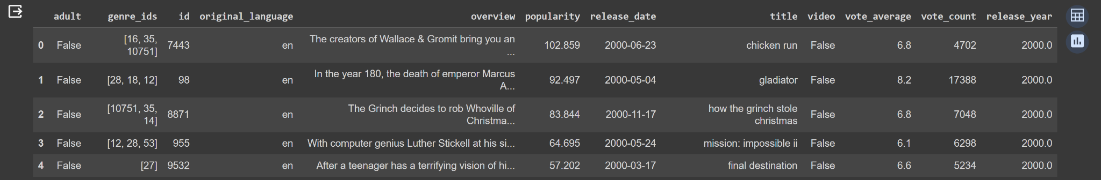
The Dataset
168658, 12

Slide 5
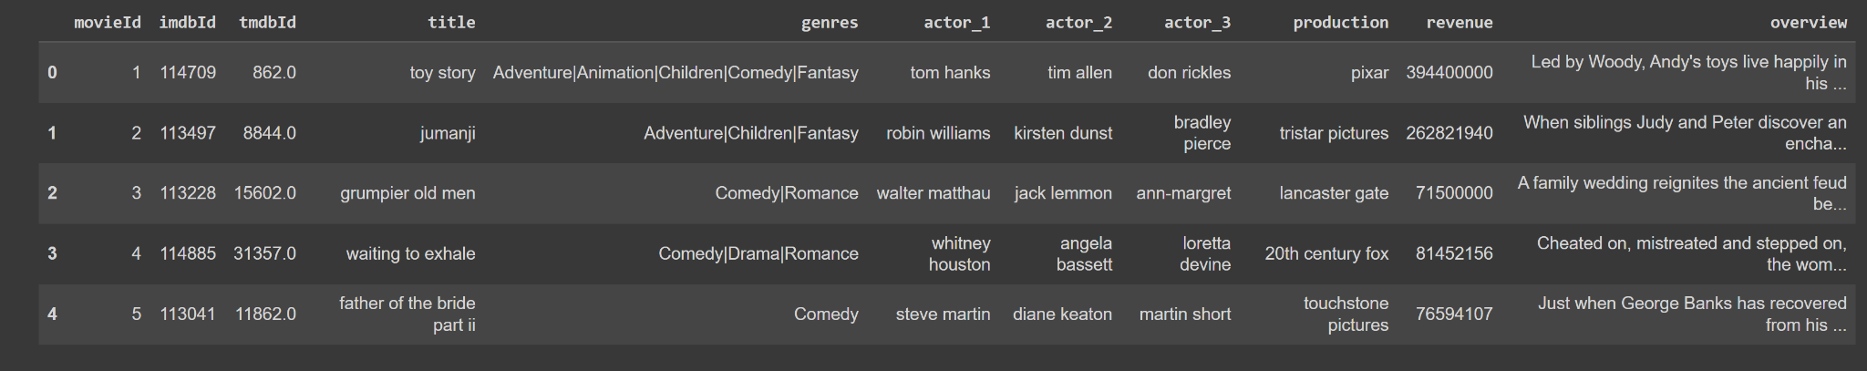

Slide 6
Data Scraping:
Grouplens API

Slide 7
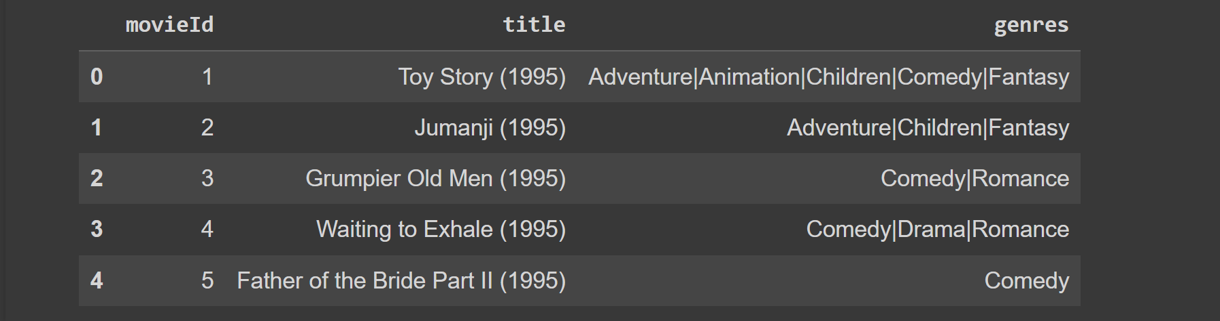
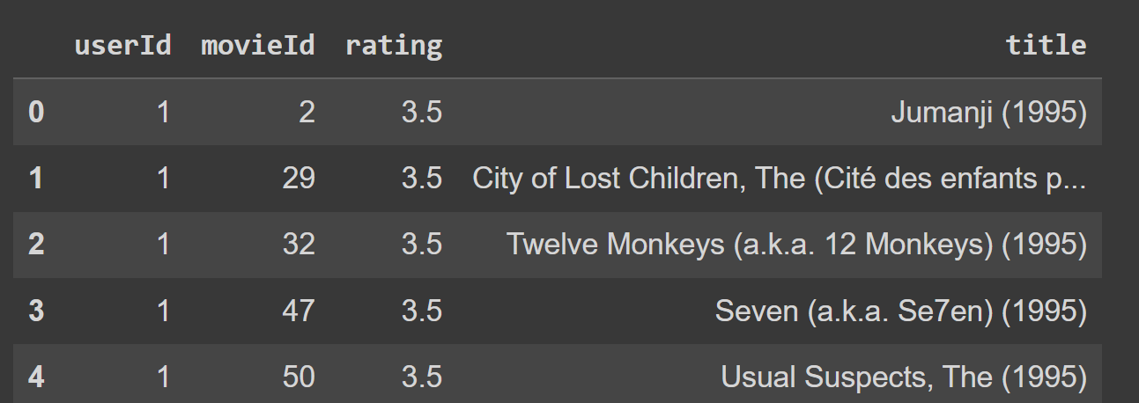
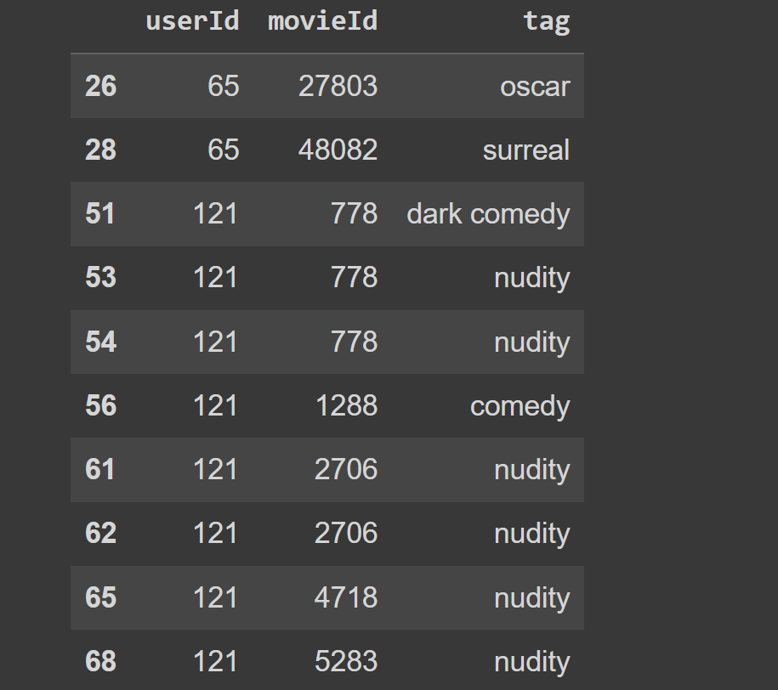

Slide 8
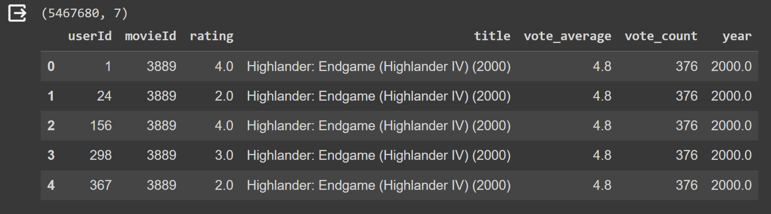
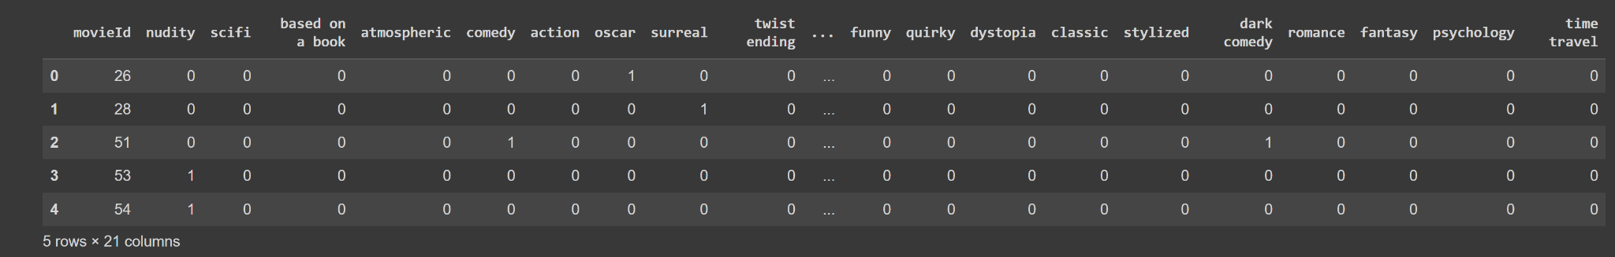
Final Datasets

Slide 9
EDA

Slide 10
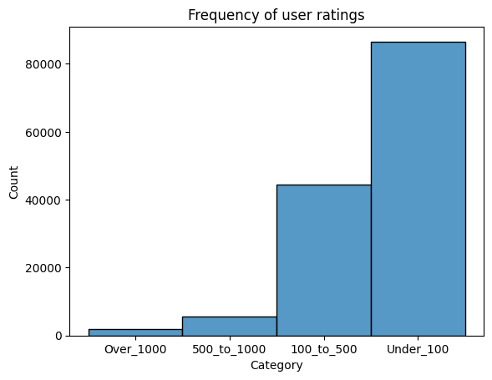
Frequency of Users

Slide 11
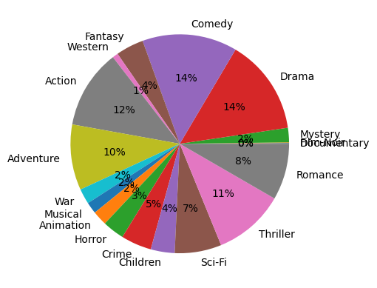
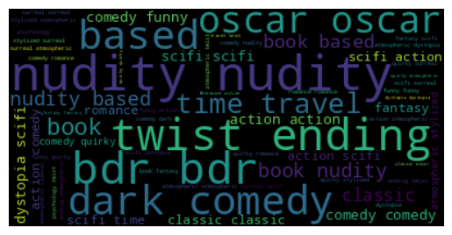
Genres and Tags

Slide 12
Neural Network

Slide 13
Why Embedding Layers
Cannot use movieId and userId as numerical input since I cannot perform mathematical functions on them.
Cannot do OHE on user and movie inputs due to scaling and efficiency issues since I had around 20M inputs
An embedding layer would map each element in a set of discrete things (like words, users, or movies) to a dense vector of real numbers (its embedding).
Aside: A key implementation detail is that embedding layers take as input the index of the entity being embedded (i.e. we can give it our userIds and movieIds as input). You can think of it as a sort of 'lookup table'. This is much more efficient than taking a one-hot vector and doing a huge matrix multiplication.

Slide 14
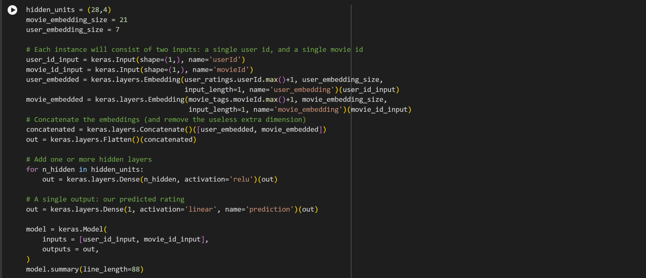
Model Created

Slide 15
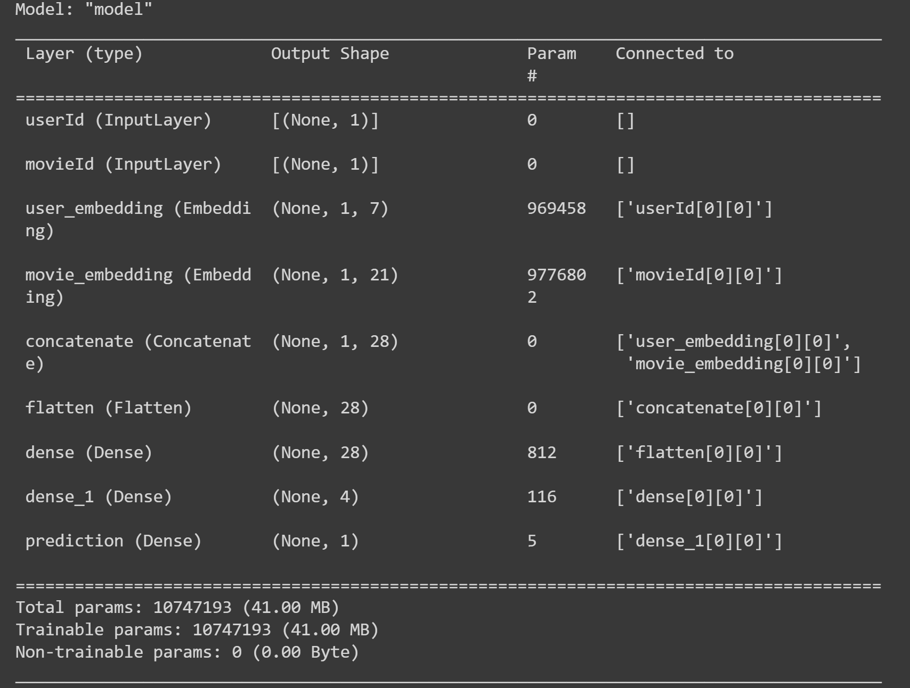

Slide 16
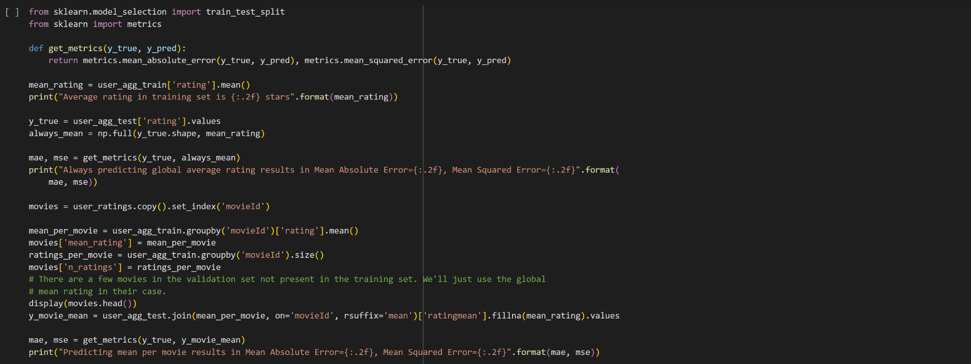
Metrics

Slide 17
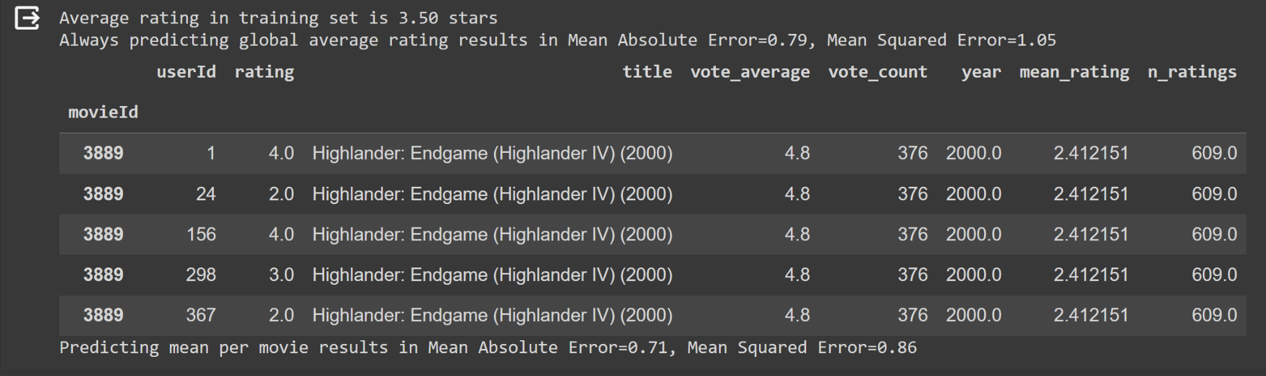

Slide 18
Creating Recommendation for users

Slide 19
For Existing Users
For existing users that have already rated movies before:
Create list of movies they have already rated.
Subtract the previously rated movies from master list of movies
Predict a rating for each movie as the user via neural networks
Create a dataframe of movieid and predicted rating
Sort by rating and return 10 highest rated movies

Slide 20
Ideally, cold users are recommended movies based on age, gender, location and a few other metrics.
However, we have used the users’ top 5 genres and movie choices to make the suggestions here.

Slide 21
For new users with less than 5 ratings
For intial users:
Ask for top 5 genres
For each selected genre, show them top 5 highest rated movies ask then to pick 10 movies from that list
Based on the movies liked suggest 10 more movies using similarity score between movies.

Slide 22
What’s missing?

Slide 23
Money
Notes:
When I started this project I wanted to predict which streaming platforms have the movies that you would enjoy the most as a user. However, that quickly got pushed aside as a lot of the streaming platform APIs have been put behind a very high paywall, resulting in the grouplens API and movielens API. I tried going back to look for maybe a pre-existing dataset

Slide 24
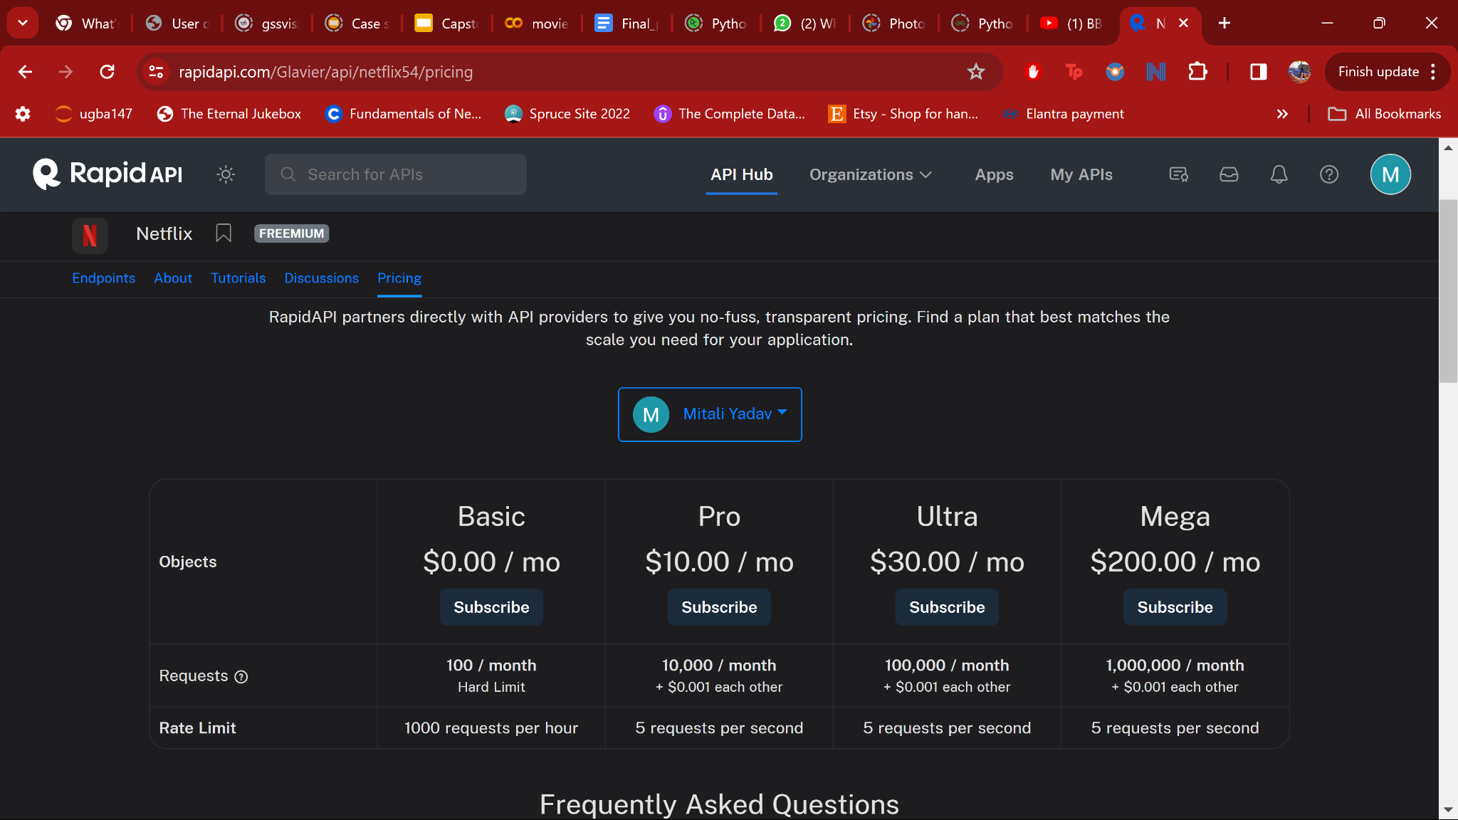
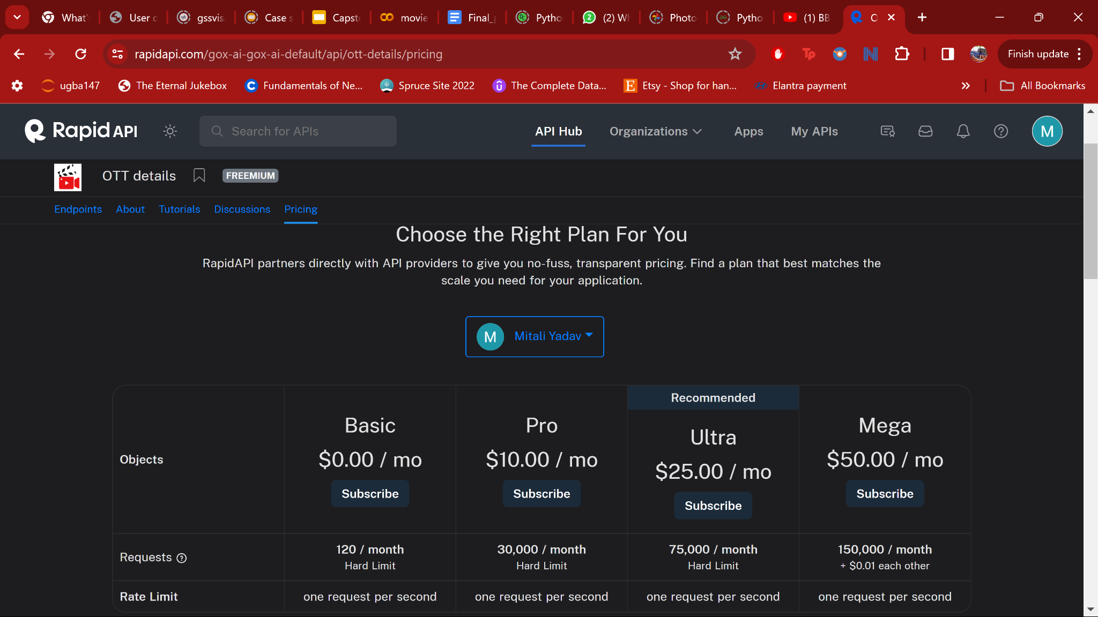
~27270 movies

Slide 25
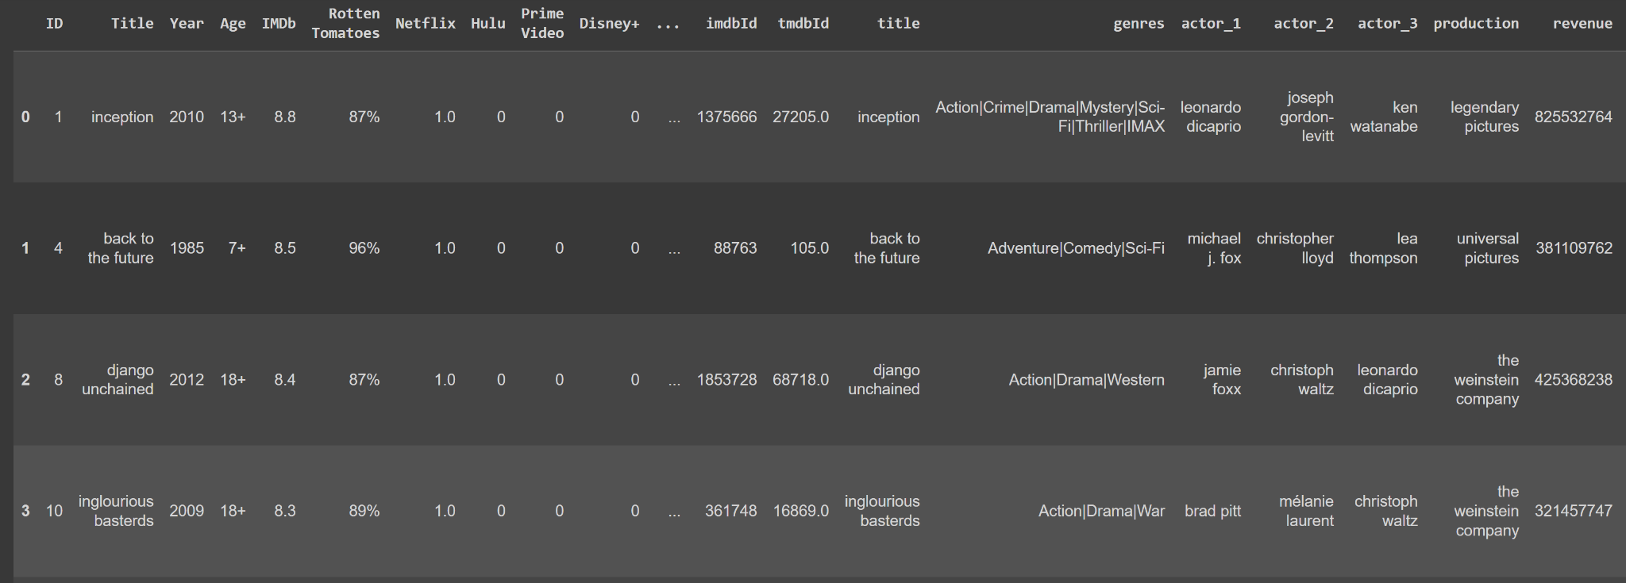
Finding a pre-existing OTT dataset
Notes:
Overlap of 3100 movies

Slide 26
Conclusion
It was incredible learning experience, starting out with an idea and overcoming the hurdles during execution, whether it was a paywall or computing power.
The neural network did reasonable well in terms of Mean Absolute Error=0.79, Mean Squared Error=1.05
In terms of shortcomings, I think if I would have liked to incorporate few more attributes of the movies into the model and used a weighted average to further reduce bias.
I would also like to create a Streamlit application for the same, and use OOP so I can add more users to this dataset as they rate more movies but currently I do not have the infra to build and maintain datasets.
Notes:
There were issues finding data, and once I found it I was drowning in it, unable to compute it all but determined to use it all as well.

